Slide 1
BRITISH AIRWAYS
A Text Analysis of Customer Review

Slide 2
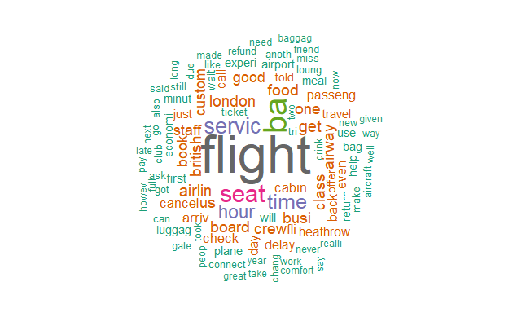
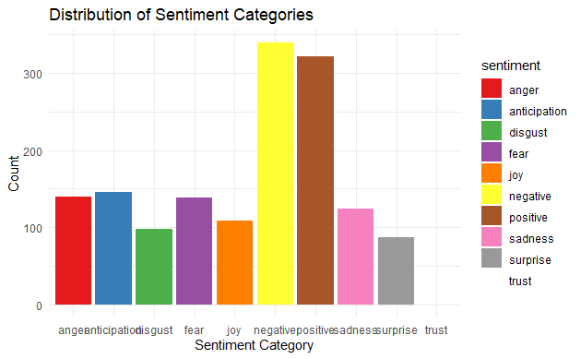
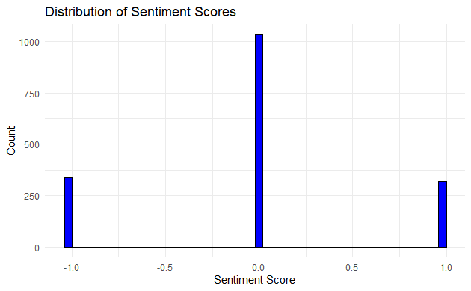
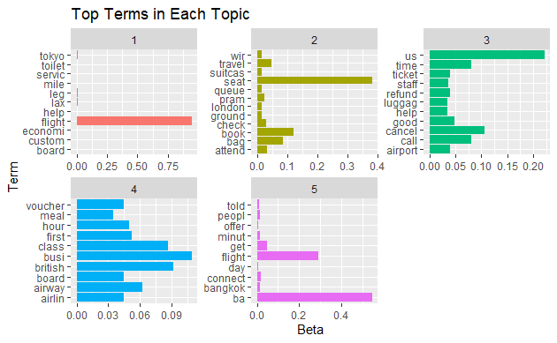
By applying NRC sentiments model which maps english words associated with eight basic emotions (anger, anticipation, disgust, fear, joy, sadness, surprise, and trust) and two general sentiments (positive and negative) words in the dataset. As seen in Figure above, the customer reviews shows lesser trust and more of negative reviews. From the sentiment score of an average of -0.01, it can be concluded that the customers are not happy with services provided to them giving rise to more negative reviews
The Extracted flight review dataset was pre-processed and a word cloud was created. From the word cloud, It can be seen that customers are focused on words like flight, time, seat, service amongst others
This report summarizes the results of a topic modeling analysis conducted on customer reviews dataset of British Airline. The analysis aimed to identify the main themes and recurring topics within the reviews, highlighting key areas of focus and concern for customers. Five distinct topics emerged from the analysis, each representing different aspects of the airline travel experience.
Flight and Economy Class Experience
Airport and Ground Services
Customer Service and Refund Issues
Airline-Specific or Premium Experience
Connections and Special Offers
Conclusion
These insights can be used to target specific areas for service improvement and tailored marketing, such as enhancing customer support for refunds, improving airport handling processes, and promoting premium and travel offer services.

